Slide 1

Ultimate Forensics Toolkit
Digital forensics tools empower investigators to uncover crucial evidence. This presentation explores the most effective tools for modern cyber investigations.

Slide 2
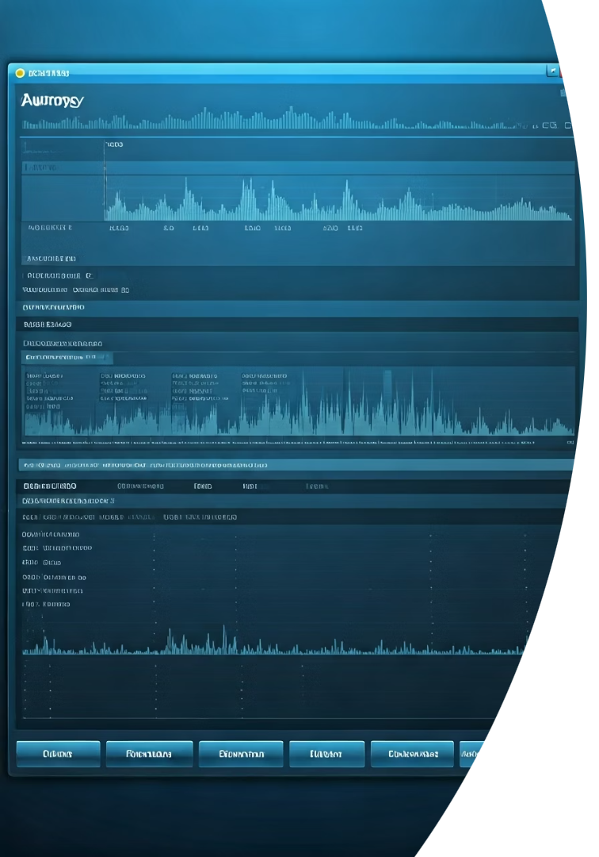




Autopsy: The Digital Investigator's Workbench
Comprehensive Analysis
Examines disk images, mobile devices, and diverse digital media formats.
Artifact Recovery
Extracts browser history, registry data, emails, and chat messages.
Timeline Construction
Creates chronological sequences of events across multiple sources.
Keyword Searching
Locates specific terms across vast datasets with advanced filtering.

Slide 3

Specialized Autopsy Add-on Modules
Media Analysis
Advanced Filtering
Video Triage splits videos into thumbnails
Code Signing Certificate Verification
Perceptual Hash creates image fingerprints
Golden Image Comparison identifies changes
Content Processing
Text Gisting analyzes foreign-language content
Log Forensics extracts Windows log data

Slide 4








Eric Zimmerman's Forensic Suite
Timeline Explorer
Builds comprehensive event chronologies
Registry Explorer
Analyzes Windows Registry artifacts
MFT/ShellBags/JumpList Tools
Examines file system and user activities
Command-line Utilities
Enables automation and batch processing

Slide 5




Registry and Execution Analysis Tools
Amcache Parser
Identifies executed programs and unassociated files. Reveals application activity even after deletion.
AppCompatCacheParser
Extracts ShimCache data with executable paths. Provides timestamps for program execution evidence.
WxTCmd
Parses Windows 10 Timeline database. Recovers 30-day history of user activities.

Slide 6








User Activity Forensics Tools
ShellBags Explorer
JumpList Explorer
Tracks folders users interacted with. Reveals navigation even after deletion.
Parses recently used files. Shows application-specific user tasks.
Timeline Explorer
MFTExplorer
Correlates events chronologically. Enables complex filtering of activities.
Analyzes file table entries. Recovers information about deleted files.

Slide 7
Disk-Level Analysis Tools
MH-Nexus HxD
Disk Editor Functions
A powerful hex editor for examining raw data at the byte level.
Provides low-level access to critical disk structures.
Examines MBR and GPT
Opens large files efficiently
Analyzes file system metadata
Calculates checksums
Recovers damaged partitions
Performs binary comparisons
Inspects hidden sectors
Enables memory editing

Slide 8

Data Sanitization and Security
Identify Media
Catalog all storage devices requiring sanitization. Document media types and capacities for verification.
Select Erasure Method
Choose appropriate KillDisk sanitization standard. Different standards offer varying security levels.
Verify Completion
Confirm successful data destruction. Generate certificates for compliance documentation.

